Slide 1
Critical Applications: Book Recommendation System
Presented by:
Sindhuja Baikadi - (02128756)
Kirankumar Sampadarao - (02142539)

Slide 2

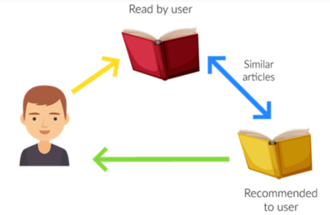
Contents
Abstract
Introduction & Motivation
Background
Problem Statement
Related Works
Dataset Overview Proposed System Architecture
Recommendation Models
Methodology
Experimental Settings, Results, Analysis
Future Work and Conclusion

Slide 3
Abstract
Recommender systems help suggest the most appropriate products to end users.
Online book-selling websites use recommendation systems to boost profits and retain buyers.
A book recommendation system aims to suggest books aligned with the buyer’s interests.
Our system combines some techniques:
1. Content Filtering: Recommends based on book features and user preferences.
2. Collaborative Filtering: Uses preferences of similar users to make suggestions.
KNN: The popular books are based on the number of ratings and creates a user-book matrix. It then uses a Nearest Neighbors model with cosine similarity to find and recommend books similar to a given one based on user ratings. The output is a list of recommended books.

Slide 4
Introduction
Recommendation systems reduce the overhead associated with making the best choices among the plenty.
Now, Recommender systems can be implemented in any domain from E-commerce to network security in the form of personalized services.
Recommender systems benefit consumers and manufacturers by suggesting items that users may not have discovered on their own.
Each system has two main entities:
1. User: Any customer or consumer receiving recommendations.
2. Item: The product or content being recommended (e.g., books).
Input: A database of users and books.
Output: Personalized book recommendations.

Slide 5
Book Recommendation Systems help users find books tailored to their preferences.
Traditional methods like seeking suggestions from friends or browsing libraries often fall short.
Objective: Develop a system that considers user interests and data to recommend books efficiently.
Motivation
Why a Book Recommendation System?
Users often struggle to find books matching their interests.
Leveraging user data (ratings, preferences) can provide personalized recommendations.
Aims to enhance the reading experience and save time for book lovers.

Slide 6
Background
Why Do We Need a Book Recommendation System?
Users face difficulty finding relevant books, Generic recommendations don’t account for diverse preferences.
Explosion of content creates overwhelming choices.
Importance of Personalized Recommendations:
Simplifies decision-making and enhances user experience, Saves time by providing tailored book suggestions.
Supports authors and publishers in reaching the right audience.
Uses data science and machine learning to analyze user behaviors.
Combines collaborative, content-based for accuracy.

Slide 7
Problem Definition
Users struggle to discover books that match their specific interests and preferences.
Existing methods like browsing libraries or seeking recommendations from friends are inefficient and subjective.
Key Challenges: Handling the vast variety of books available (different genres, authors, publishers).
Addressing diverse user preferences, as each user has unique reading habits and tastes. Incorporating limited user interaction data into the recommendation system.
Research Problem:
How can we build an efficient and accurate book recommendation system that:
Understands user preferences.
Utilizes user ratings, content data (e.g., book titles, authors).
Provides personalized book suggestions.

Slide 8
Related Works:
Several recommendation systems exist:
Collaborative filtering: Uses user interactions to suggest items.
Content-based filtering: Leverages attributes of items.
Hybrid approaches: Combine collaborative and content-based techniques.
Associate Rule Mining.
Popularity Based.

Slide 9
Dataset Overview
The dataset we have used in this work is the Book-Crossing User review ratings that comprises three tables:
Books- It has 8 columns; ISBN, Book title, Book author, Year of publication, Publisher, and three columns for Book cover Image URLs representing three different versions (small, medium, and large).
Users- Contains the user’s information. It consists of 3 columns UserID, Location, and Age.
Ratings- Contains the information on ratings of the books. It consists of 3 columns UserID, ISBN, and Book Rating.
Dataset link: https://www.kaggle.com/datasets/ruchi798/bookcrossing-dataset/data

Slide 10
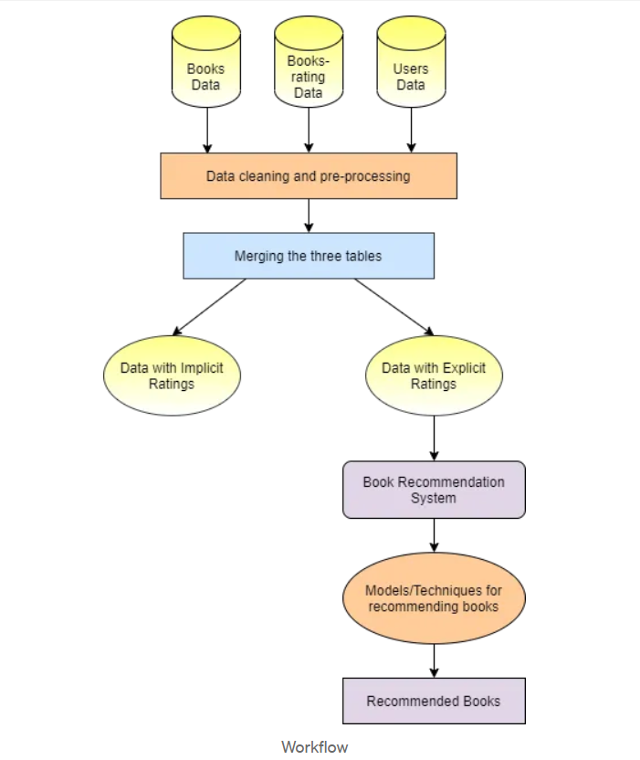
Proposed System Architecture

Slide 11
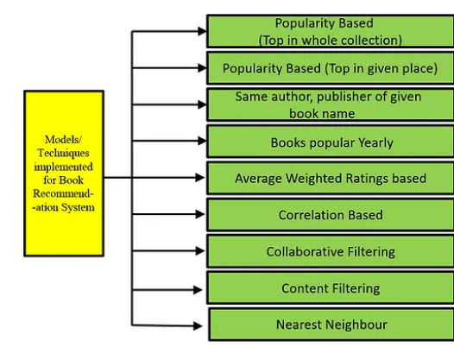
Recommendation Models
1. Popularity-based:
Overall top-rated books.
Top-rated books by location.
Books by same author, publisher of given book name
Books popular Yearly
2. Content-based:
Similar books based on titles.
3. Collaborative filtering:
User-item filtering for personalized recommendations.
4. Correlation Based 5. KNN

Slide 12
Methodology
Framework Overview:
Existing Work/Approaches Used:
Collaborative Filtering: Leverages user ratings and similarities between users to suggest books.
Content-Based Filtering: Analyzes book attributes (e.g., titles, authors) to recommend similar books.
Proposed Framework:
Data Pre-processing:
Cleaned and standardized the Books, Users, and Ratings tables.
Removed duplicate and invalid entries (e.g., invalid years, invalid ISBNs).
Filtered out books with insufficient data (e.g., ratings below a threshold).

Slide 13
Feature Engineering
Generated TF-IDF vectors for book titles for content-based filtering.
Built a user-item interaction matrix for collaborative filtering.
Models Applied:
Popularity-based: Recommends top-rated books globally or by user location.
Nearest Neighbors: Identifies books similar to a user’s preferences using cosine similarity.
Weighted Scoring: Combines total ratings and average ratings for better recommendations.
Steps to Build the Framework:
Prepare and merge the datasets (Books, Users, Ratings).
Use content-based and collaborative filtering for individual recommendations.

Slide 14
Experimental Settings
Input data preparation:
User-book rating matrix for collaborative filtering.
TF-IDF vectors for content-based filtering.
Merged the three tables into a single dataset.
Filtered out ratings with a value of 0.
Used valid entries for experimental analysis (e.g., books with at least 50 ratings).
Parameters:
Minimum ratings for inclusion: 50 (collaborative filtering).
Similarity metric: Cosine similarity.
Training/Test Splits:
Split the dataset into 75% for training and 25% for testing for validation of models.
Stratified splitting to ensure distribution across user ratings.

Slide 15
Experimental Results and Analysis
Popularity-based: Highly rated books recommended.
Content-based: Similar books suggested based on title.
Collaborative Filtering (User-Item): Leveraged user-book rating matrix to identify similar users and recommend books.
Visualization Insights:
Rating distribution revealed most books received scores of 8 or higher.
The correlation-based approach highlighted strong similarities between highly rated books.
Book-rating distribution, top recommendations.

Slide 16
Future Work:
Incorporate real-time user feedback.
Expand dataset for better generalization.
Experiment with deep learning techniques.
Conclusion:
Successfully built a recommendation system using diverse models.
Enhanced user experience with personalized book suggestions.

Slide 17
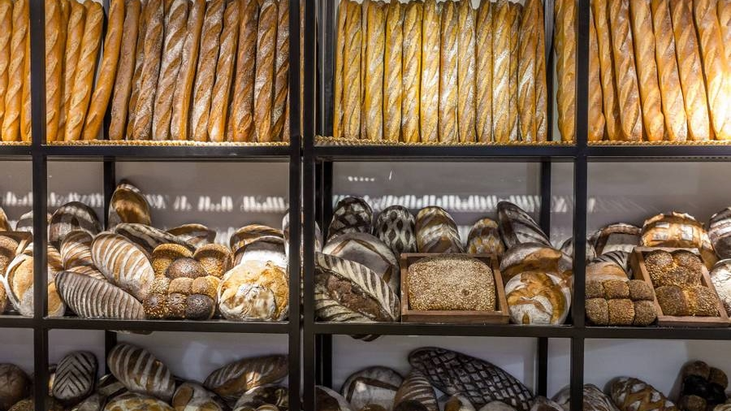
Thank you
17

